Slide 1
CAR 163916626
- Duncan Li (Q1)
- Samantha (Q2-Q5)
- Vinutha M.U (Q6-Q7)

Slide 2
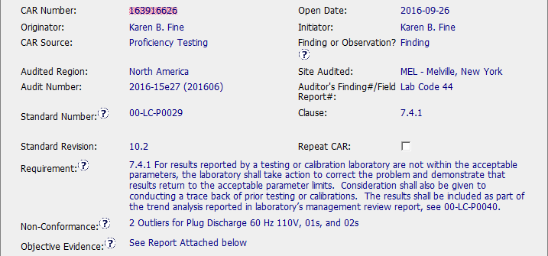
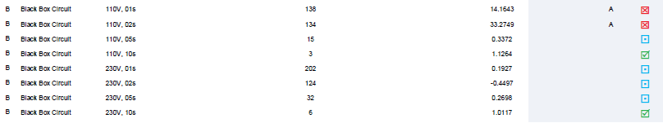
CAR 163916626
Additional Comment:
IFM Plug Discharge Test PT results failures, 2 of 16 results as outlier.
1 sec, 2 sec of 110 V failure.

Slide 3
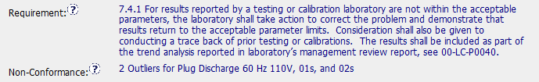
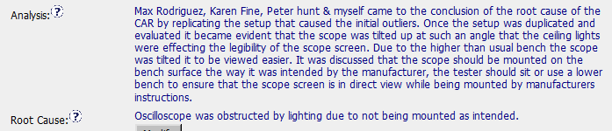
CAR 163916626
1
(Q1) Explain how/If the nonconformity is fully addressed in the analysis
The analysis had found outlier issue was caused by oscilloscope setup. But, “Lack of knowledge”, “human error”, or “item overlooked” typically require more investigation to get closer analysis result, for example, why technician did not follow manufacture instructions to oscilloscope? Maybe it was because Working Instruction was not easy understanding or there was no details process in Working Instruction .
Additionally, I would suggest they shall additionally do more researches to make sure there was no any impact for certification and currently Lab operation

Slide 4
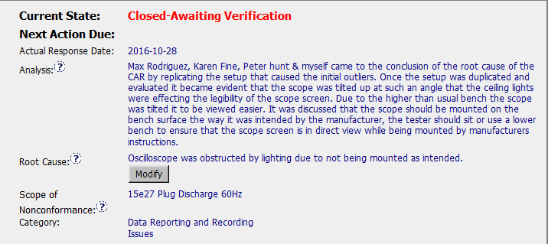
CAR 163916626
(Q2) Explain how/If the analysis supports the root cause statement
Partially. The analysis is supporting the root cause statement, but I would suggest to analyze more why the test was not set up as manufacturers instructions.
2
3
(Q3) Explain how/If the analysis supports the Scope of Nonconformance statement
Partially. It needs to provide a description of how far the issue extends. I would suggest to change it from ‘15e27 Plug Discharge 60Hz’ to the statement which can check whether the test set up impacted on other testing that the lab performed.

Slide 5
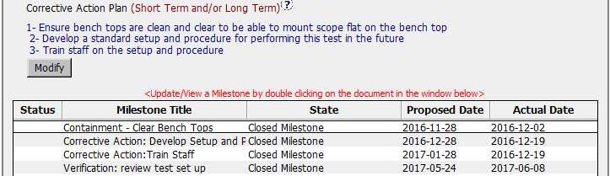
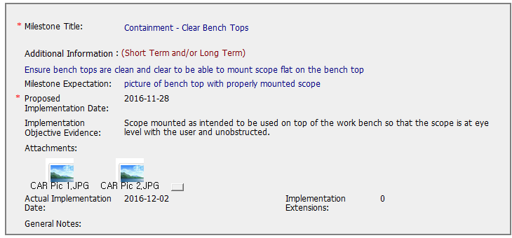
CAR 163916626
(Q4) Explain why/If the Corrective Action Plan will prevent the recurrence of the nonconformity
Partially. They developed a standard setup and procedure for performing the test and delivered training. However there is no evidence like copy of sign in sheet , description of training, training effectiveness verification.
4
5
(Q5) Explain how/If the containment milestone “stopped the bleeding”
Partially. CAR Owner conducted a immediate action to make bench top with properly mounted scope and attached pictures. As for the milestone expectation, I would suggest to add technical manager’s review and approval.

Slide 6
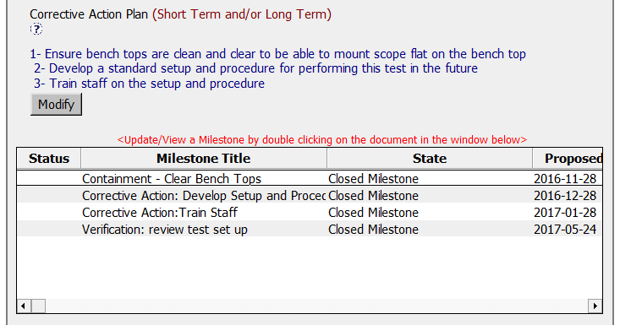
CAR 163916626
6
(Q6) Confirm that/If all corrective action milestones are aligned to each item of the corrective action plan
Partially. Corrective action milestones are partially aligned as Verification milestone is available but same is missing in corrective action plan.
Points to consider-
1) Corrective action-Test setup and procedure document is not controlled.-(In DCS)
2) Interim milestone would have been added as there is more than 3 months gap between Milestone #3 and #4. Refer-FAQ 35.
3) Evidences are not as per milestone expectations.

Slide 7
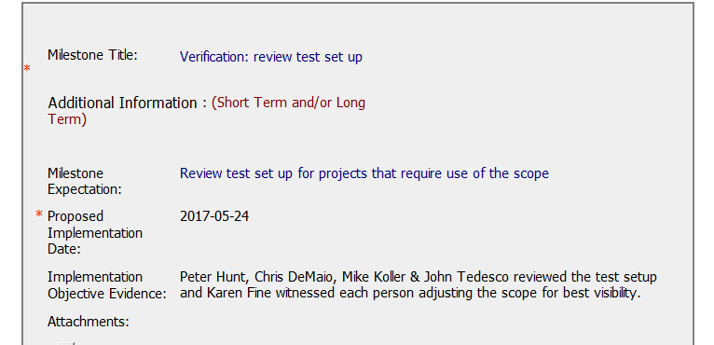
CAR 163916626
(Q7) Explain how/If the verification milestone confirmed the effective implementation of the corrective action plan.
Partially-
Only names of the staff who reviewed the test set up is mentioned. Adding review report which is signed off by the reviewers as an evidence would confirm the effective implementation
7

Slide 8
CAR 163916626
Criteria | CAR Review Results
(Q1) Explain how/If the nonconformity is fully addressed in the analysis | Partially, it is required to do more investigation to get closer analysis result.
(Q2) Explain how/If the analysis supports the root cause statement | Partially. The analysis is supporting the root cause statement, but I would suggest to analyze more why the test was not set up as manufacturers instructions.
(Q3) Explain how/If the analysis supports the Scope of Nonconformance statement | Partially. It needs to provide a description of how far the issue extends. I would suggest to change it from ‘15e27 Plug Discharge 60Hz’ to the statement which can check whether the test set up impacted on other testing that the lab performed.
(Q4) Explain why/If the Corrective Action Plan will prevent the recurrence of the nonconformity | Partially. They developed a standard setup and procedure for performing the test and delivered training. However there is no evidence like copy of sign in sheet , description of training, training effectiveness verification.
(Q5) Explain how/If the containment milestone “stopped the bleeding” | Partially. CAR Owner conducted a immediate action to make bench top with properly mounted scope and attached pictures. As for the milestone expectation, I would suggest to add technical manager’s review and approval.
(Q6) Confirm that/If all corrective action milestones are aligned to each item of the corrective action plan | Partially. Corrective action milestones are partially aligned as Verification milestone is available but same is missing in corrective action plan. I would suggest to add interim milestone between milestone 3 and 4. Also evidences are not as per milestone expectations
(Q7) Explain how/If the verification milestone confirmed the effective implementation of the corrective action plan | Partially. Only names of the staff who reviewed the test set up is mentioned. Adding review report which is signed off by the reviewers as an evidence would confirm the effective implementation

Slide 9
Explain how/If the analysis supports the Scope of Nonconformance statement - Dale
Scope of Non-Conformance: 15e27 Plug Discharge 60Hz
Analysis: The scope points only to the sample identified in the non-compliance. Nothing is indicating that other previous tests were reviewed.
The analysis clearly does NOT support that a Scope assessment was done.

Slide 10
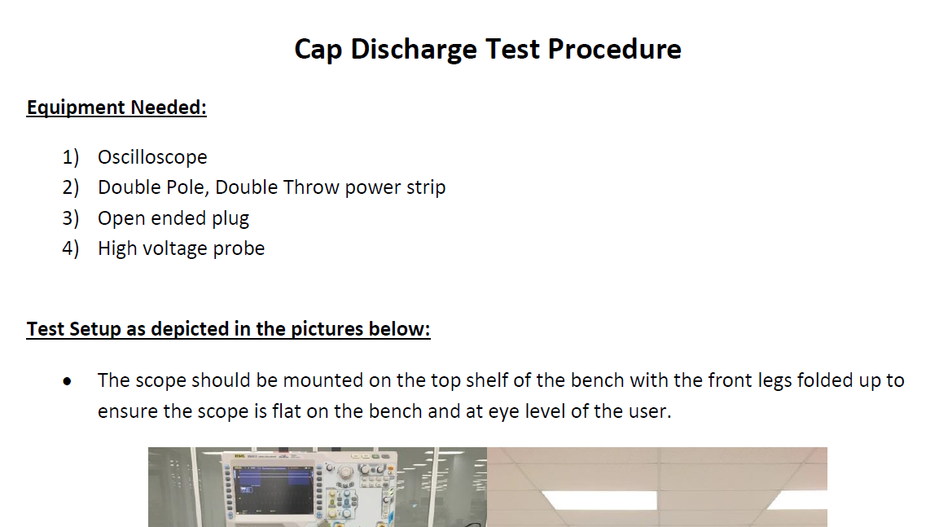
CAR 163916626 Explain why/If the Corrective Action Plan will prevent the recurrence of the nonconformity - Chris
The Corrective Action Plan will prevent the recurrence of the nonconformity, as a standard setup and procedure has been created to address the nonconformity, and staff have been trained on the new process

Slide 11
Explain how/If the containment milestone “stopped the bleeding” - JIM
Containment: Clear Bench Tops: Ensure bench tops are clean and clear to be able to mount scope flat on the bench top. Objective evidence: Scope mounted as intended to be used on top of the work bench so that the scope is at eye level with the user and unobstructed.
The Containment ensured the problem was resolved – the scope can now be mounted to be viewed directly, thereby eliminating the glare on the screen.

Slide 12
Confirm that/If all corrective action milestones are aligned to each item of the corrective action plan - Dale
Corrective Action Plan:
1- Ensure bench tops are clean and clear to be able to mount scope flat on the bench top - Aligned;
2- Develop a standard setup and procedure for performing this test in the future - Aligned;
3- Train staff on the setup and procedure - Aligned;
All milestones (except for reference to a verification) align with the CAP.

Slide 13
CAR 163916626 Explain how/If the verification milestone confirmed the effective implementation of the corrective action plan - Chris
Owner’s Verification:
Peter Hunt, Chris DeMaio, Mike Koller & John Tedesco reviewed the test setup and Karen Fine witnessed each person adjusting the scope for best visibility.
Direct Verification of the test setup was witnessed by the CAR Admin.

